Slide 1
Deep learning in R using MXNet
Qiang Kou
H2O.ai / Indiana University
qiang@h2o.ai
July 20, 2016
CONFIDENTIAL

Slide 2
What is MXNet?

Slide 3
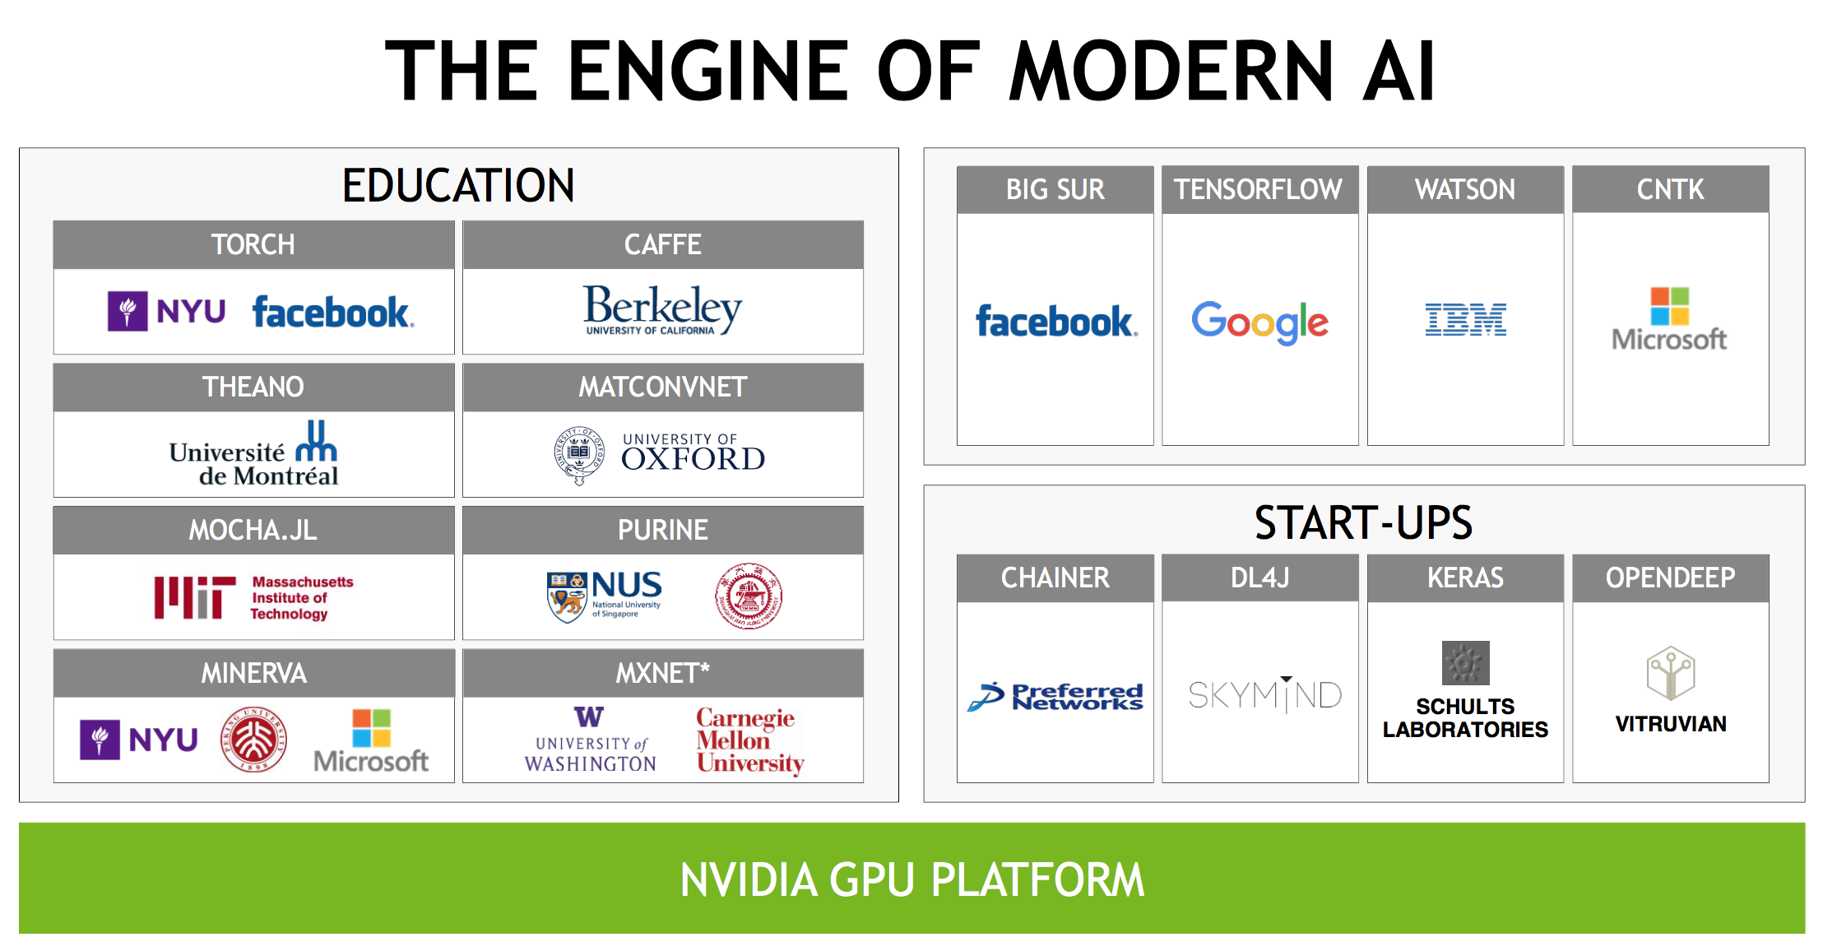
http://www.slideshare.net/NVIDIA/nvidia-ces-2016-press-conference

Slide 4
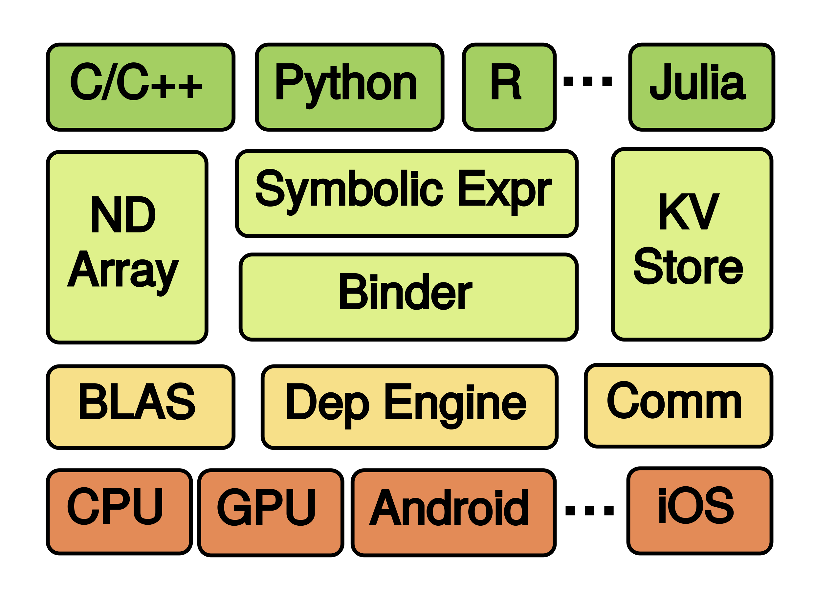
MXNet: A Flexible and Efficient Machine Learning Library for Heterogeneous Distributed Systems

Slide 5
Why MXNet?

Slide 6
Flexibility
Efficiency
Portability

Slide 7
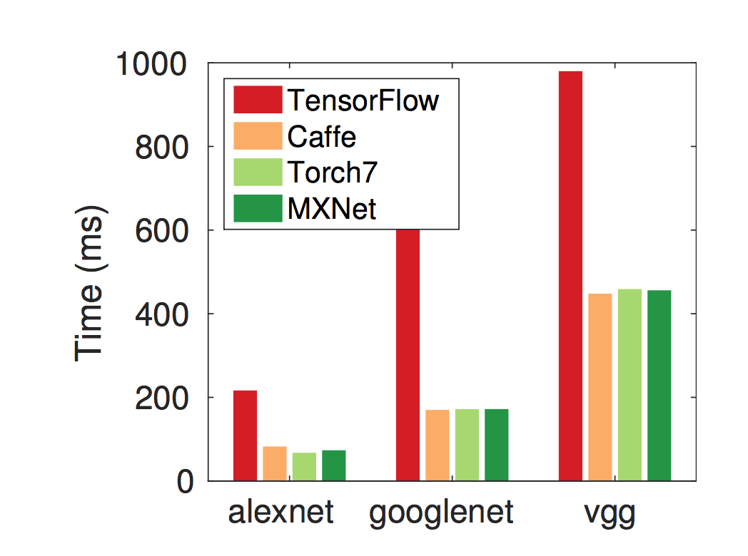

Slide 8
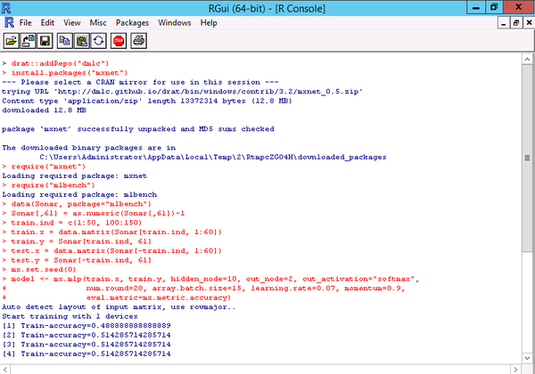

Slide 9
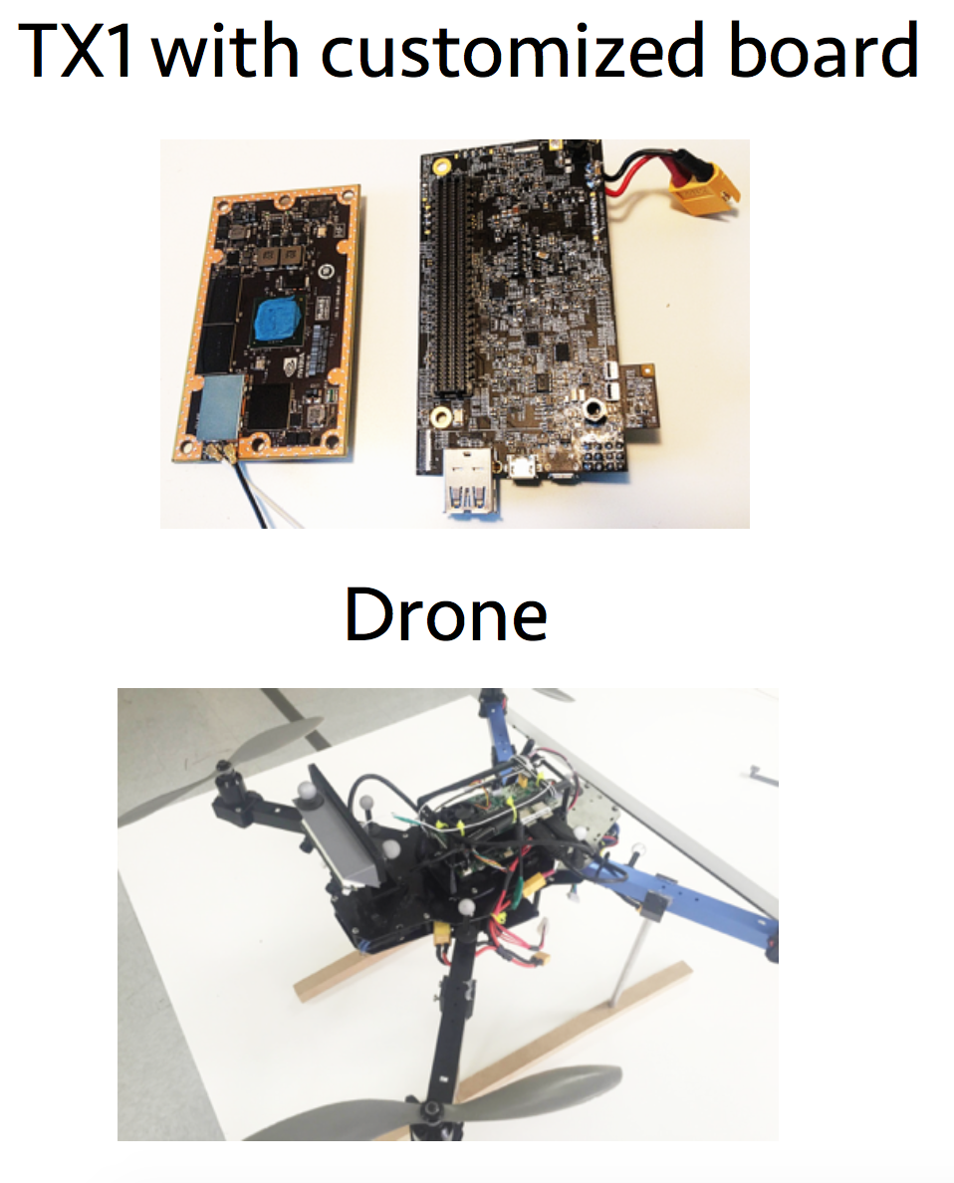

Slide 10
Windows/OSX users can install mxnet by using

Slide 11
MNIST demo

Slide 12
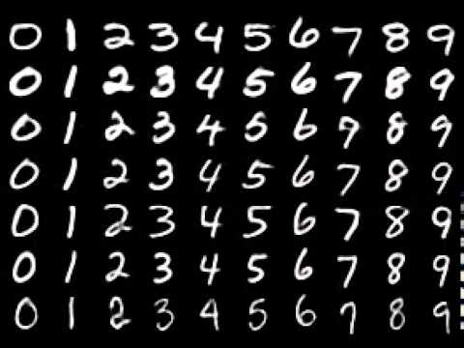

Slide 15
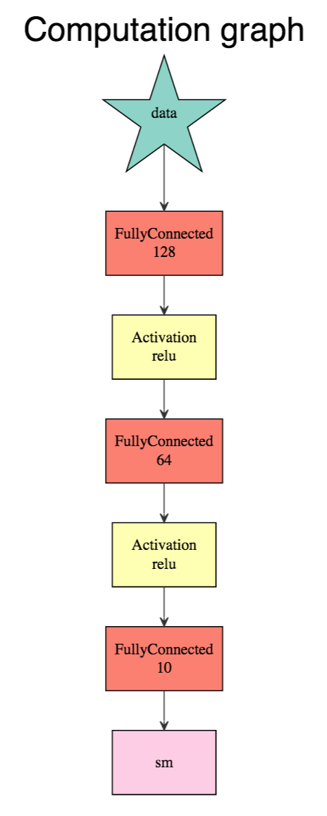

Slide 19
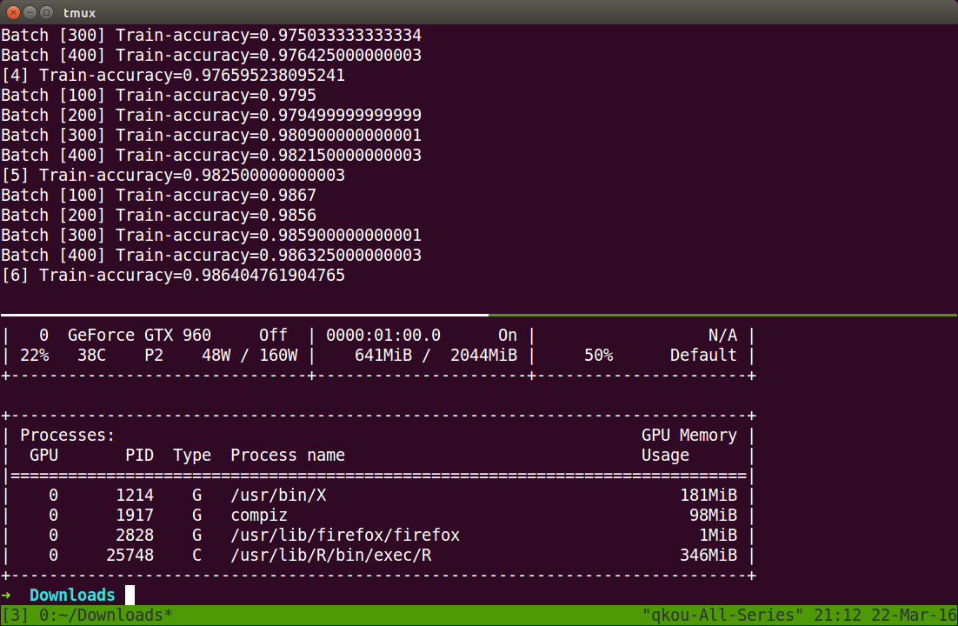

Slide 20
A Shiny App

Slide 21
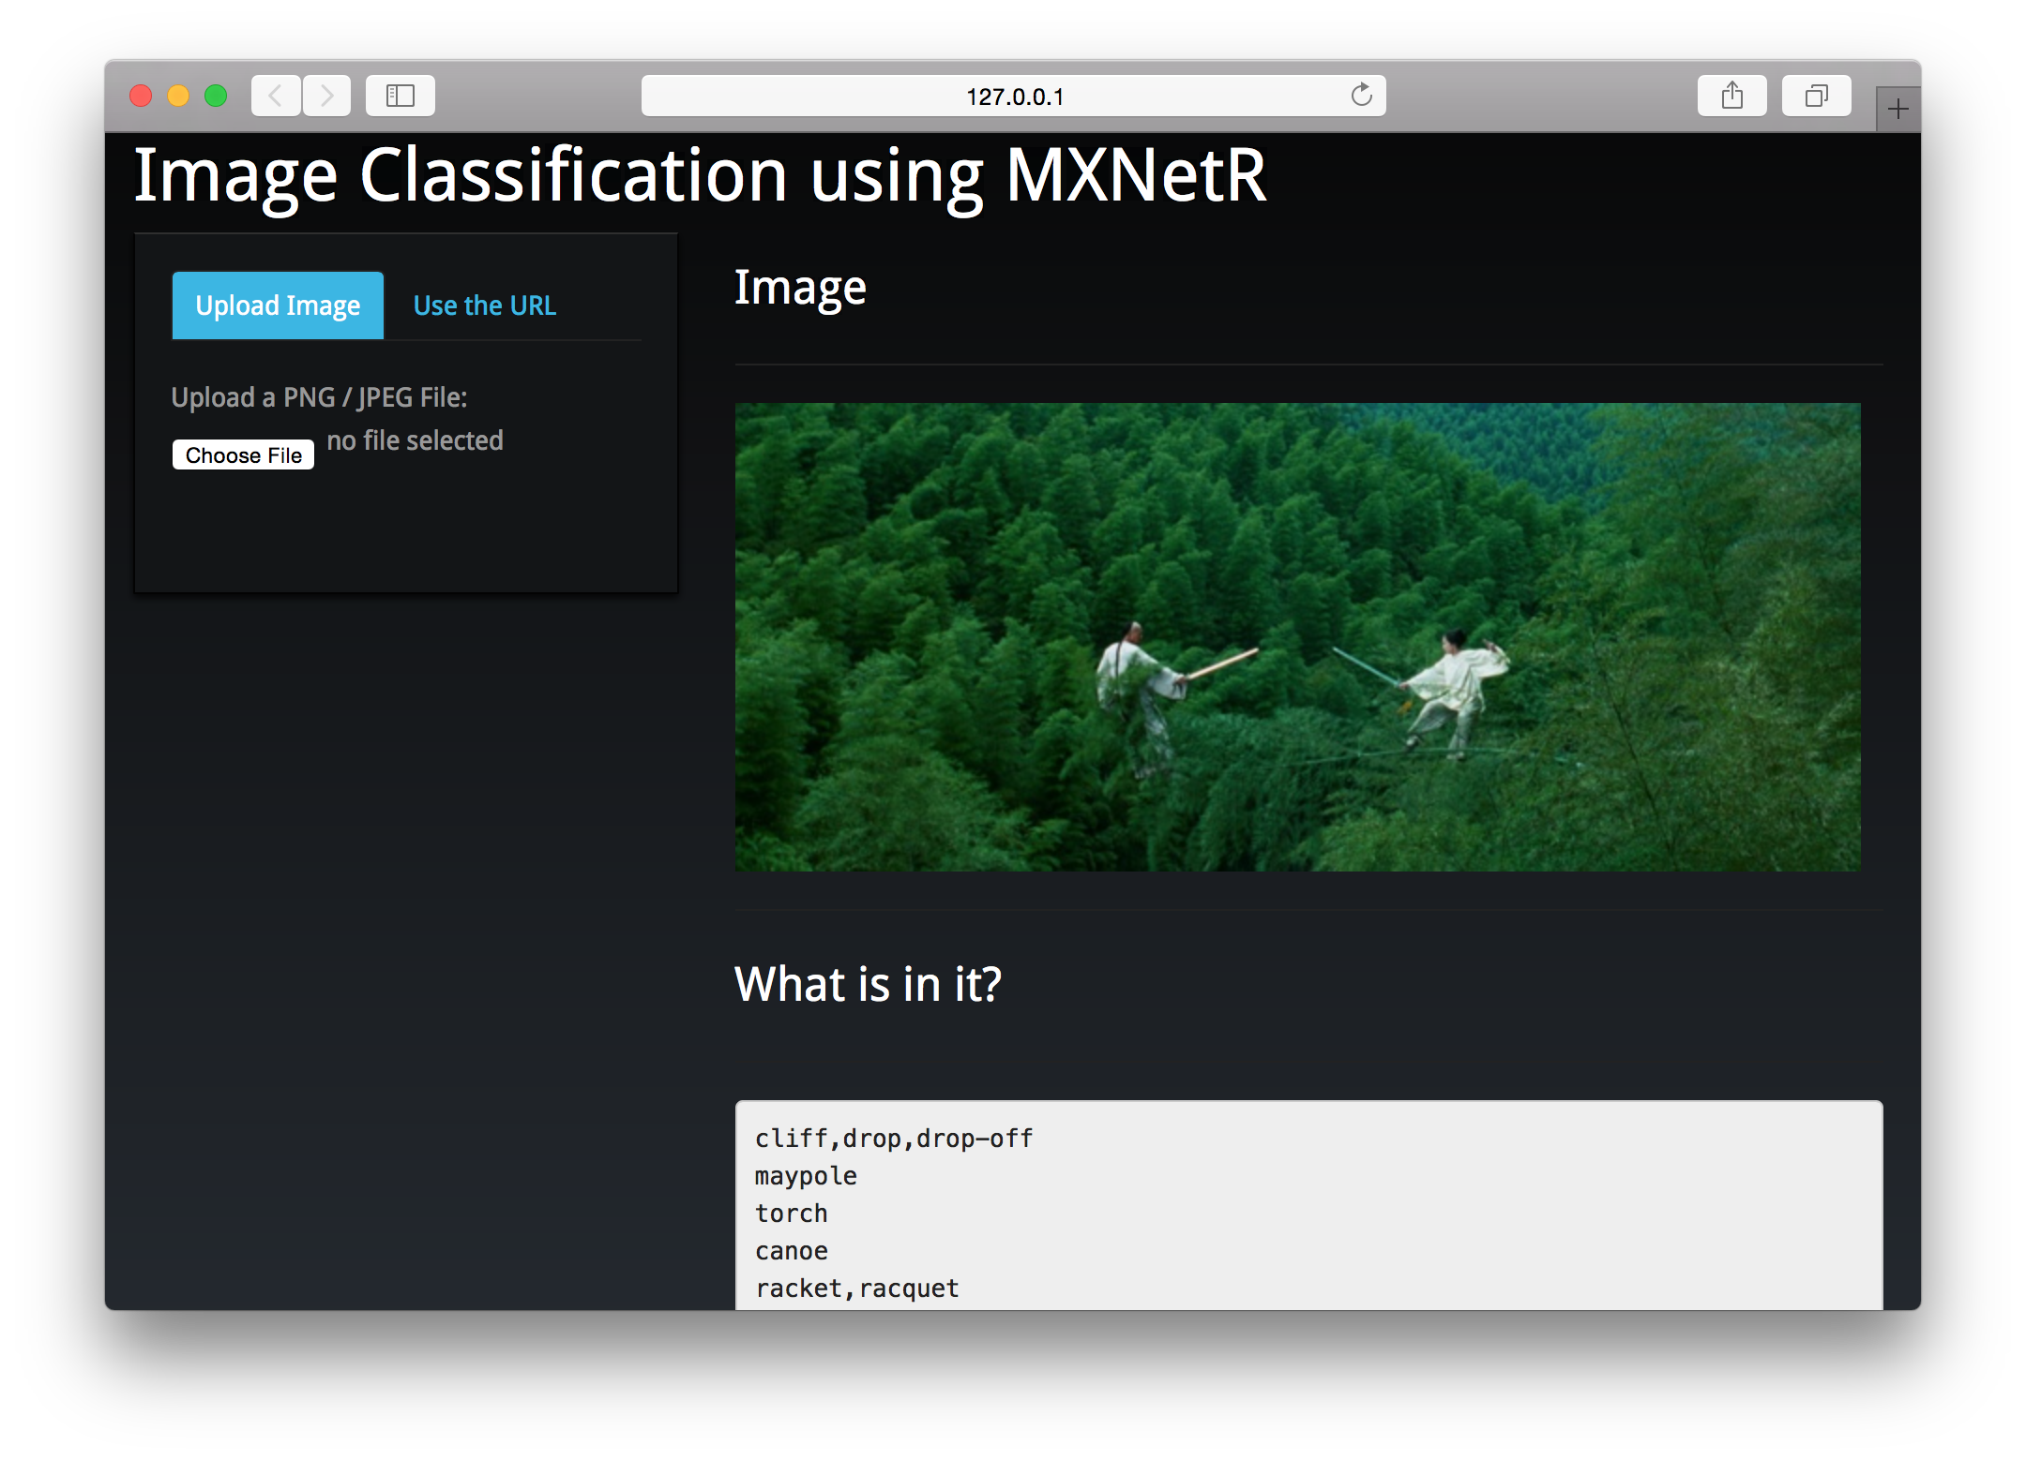

Slide 22


Slide 23


Slide 24
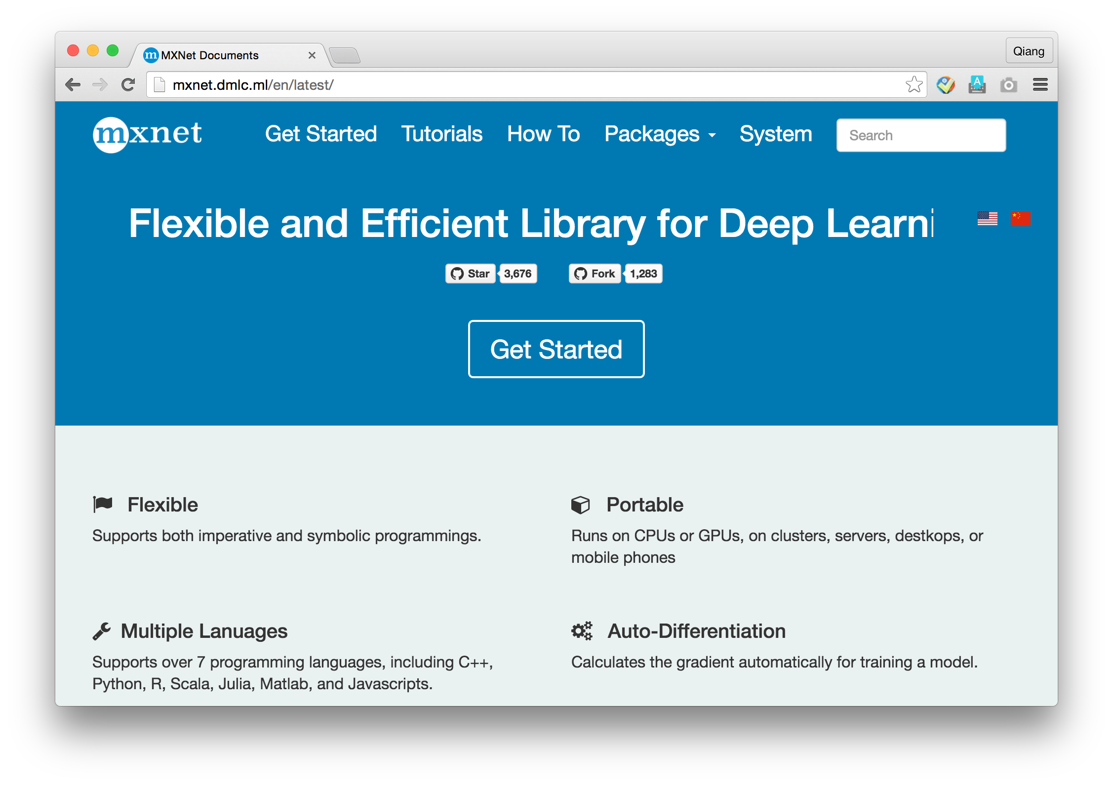
http://mxnet.dmlc.ml/

Slide 25
Thank you!

